Slide 1


Slide 2
Audit Management System
POD-1
(2153816) Aditi Mandal
(2154266) Mohan Navale
(2151652) Katuri Teja Sri
(2151515) Annadevara Srivalli
(2151511) Ishwarya Singavarapu
Pod Leader:
Katuri Teja Sri
Mentor Name:
Bravin Ninja Chandrapaul

Slide 3
Table Of Contents
INTRODUCTION
HARDWARE & SOFTWARE USED
TECHNOLOGY/FRAMEWORK USED
SYSTEM ARCHITECTURE DIAGRAM
USE CASE DIAGRAM
MICROSERVICES
CODE COVERAGES / TESTING
FRONTEND FORM VALIDATIONS

Slide 4
Introduction
A leading Supply chain Management Organization wants to automate the Audit processing, to make the management scalable and ensure clarity and ease of tracking.
The portal provides various functionalities like Audit Authorization, Audit Benchmark, Audit Checklist, Audit Severity.

Slide 5
Hardware and Software Used
Hardware
Software
Developer Desktop PC with 8GB RAM.
Spring Tool Suite / Eclipse IDE
H2 Database
Configure Maven in Eclipse
Maven
Postman client in chrome
AWS
Visual Studio Code

Slide 6
Technology/Framework Used
Angular (Frontend)
Spring web with Spring boot , Spring data jpa , H2 In Memory DB (Backend)

Slide 7
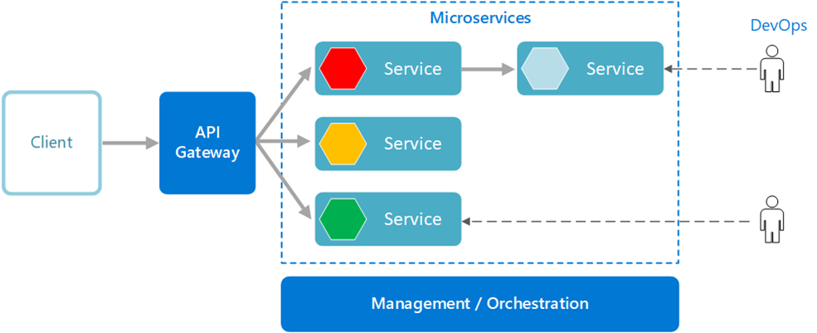
System Architecture Diagram

Slide 8
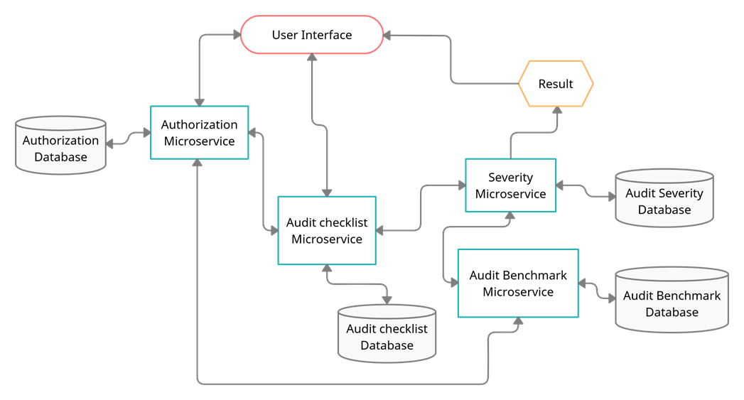
Flow Chart

Slide 9
Functional Requirements
The project consists of Four microservices. They are:-
Audit Authorization
Audit Benchmark
Audit Checklist
Audit Severity

Slide 10
AUDIT AUTHORIZATION MICROSERVICE
The intent of this Microservice is to provide the Authentication and Authorization part of project.
It creates JWT (JSON Web Token) for an authenticated user who is in Database and then it validates the user based on the JWT token passed in the "Authentication"-Request-Header.

Slide 11
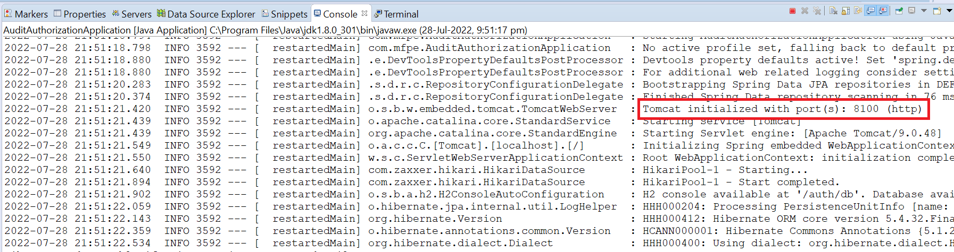
Running on Port 8100

Slide 12
Audit Checklist Microservice
The intent of this Microservice is to provide the list of questions for Audit checklist.
Post Authorization using JWT, the web portal invokes Audit Checklist Microservice GET action method with audit type.
The microservice gets the audit type and returns the checklist questions thereby displaying the questions on the Web UI.
It is invoked from Audit management Portal (local MVC App).

Slide 13
Question List
Internal
Have all Change requests followed SDLC before PROD move?
Have all Change requests been approved by the application owner?
Are all artifacts like CR document, Unit test cases available?
Is the SIT and UAT sign-off available?
Is data deletion from the system done with application owner approval?

Slide 14
SOX (Questions list)
Have all Change requests followed SDLC before PROD move?
Have all Change requests been approved by the application owner?
For a major change, was there a database backup taken before and after PROD move?
Has the application owner approval obtained while adding a user to the system?
Is data deletion from the system done with application owner approval?

Slide 15
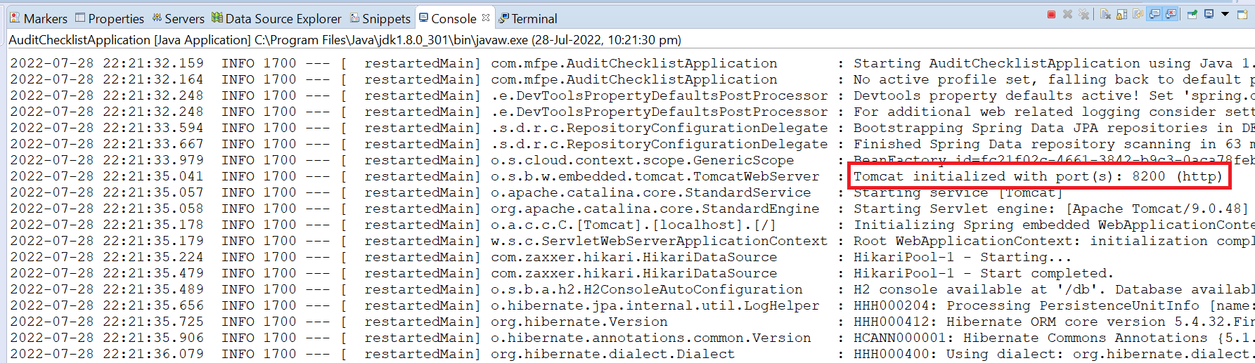
Running on Port 8200

Slide 16
Audit Benchmark Microservice
Audit Severity Microservice interacts with Audit Benchmark Microservice. Audit Benchmark Microservice allows the following operations:
This Microservice provides the acceptable benchmark value for every audit type. It returns a Dictionary of values with Audit Type and acceptable benchmark values of the number of questions whose answers can be NO/YES
Audit type: Internal
Audit type: SOX

Slide 17
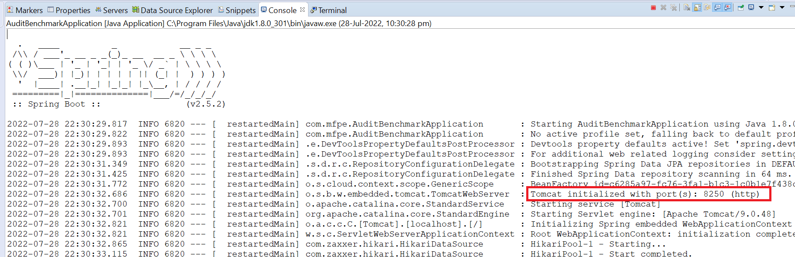
Running on Port 8250

Slide 18
Audit Severity Microservice
Audit Severity Microservice is invoked from Audit management portal. Post authorization of request, it allows the following operations:
Based on the Audit request input, the Audit Benchmark Microservice is invoked to analyse the count of questions whose answer can be NO.
The project execution status is also determined and the remediation duration details are obtained.

Slide 19
If the value is within the acceptable limit, then no action is needed, else action should be taken within a specific span of time. The logic is listed below:
Audit type – Internal; Count of NO <= acceptable value ; Audit result – GREEN; Remedial action duration: No action needed
Audit type – Internal; Count of NO > acceptable value ; Audit result – RED; Remedial action duration: Action to be taken in 2 weeks
Audit type – SOX; Count of NO <= acceptable value ; Audit result – GREEN; Remedial action duration: No action needed
Audit type – SOX; Count of NO > acceptable value ; Audit result – RED; Remedial action duration: Action to be taken in 1 week

Slide 20
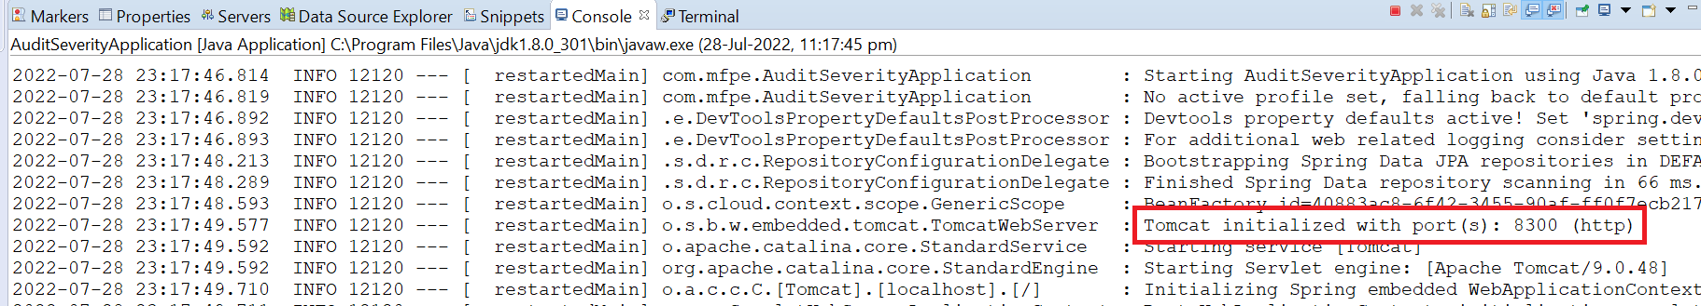
Running on Port 8300

Slide 21
Front-End (Using Angular)
Frontend is the part of the project from where user interacts with the website (user interface).
Angular is a component-based framework for building scalable applications.
When user enters data into the login page of the website userid and password would be authenticated by the server.
If the id and password is correct, only then we can use all the services of the project.

Slide 22
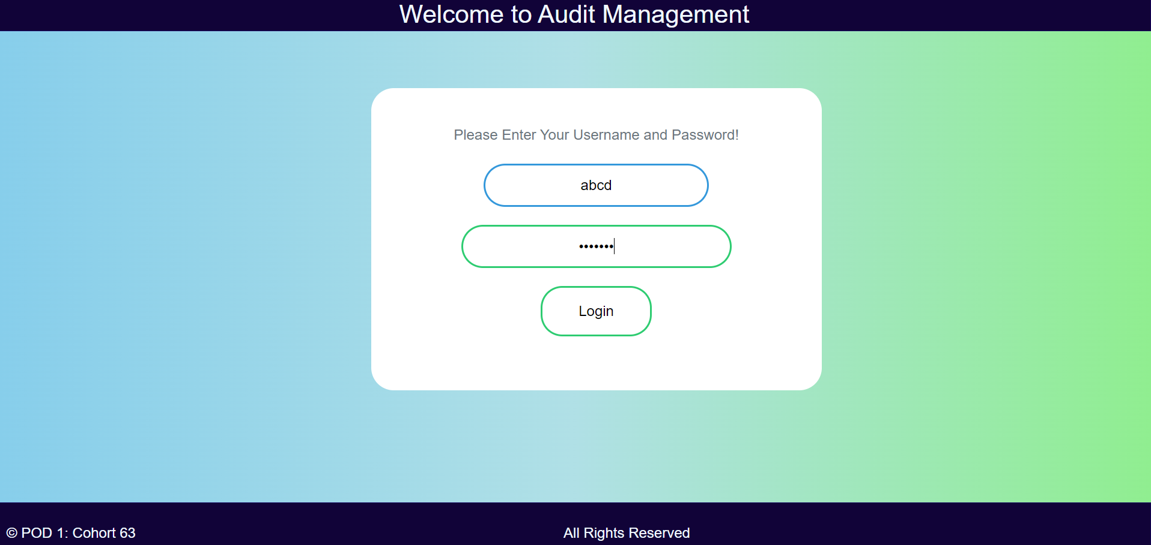
Form Validation
Entering wrong username and password

Slide 23
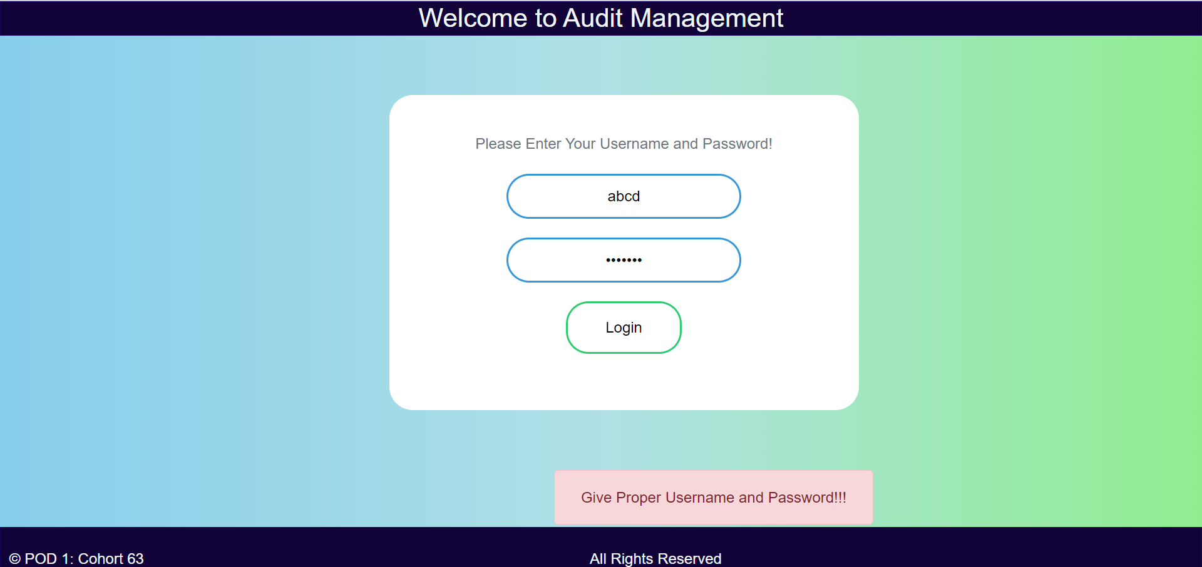
OUTPUT

Slide 24
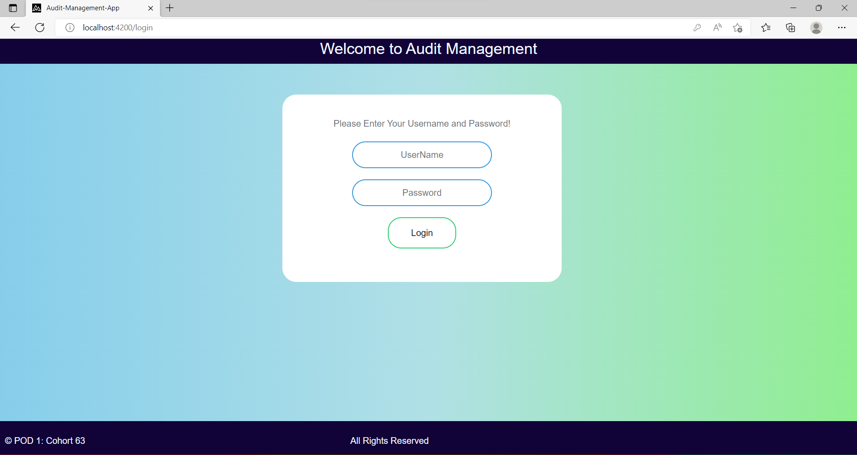
Front-End Layout Using Angular

Slide 25
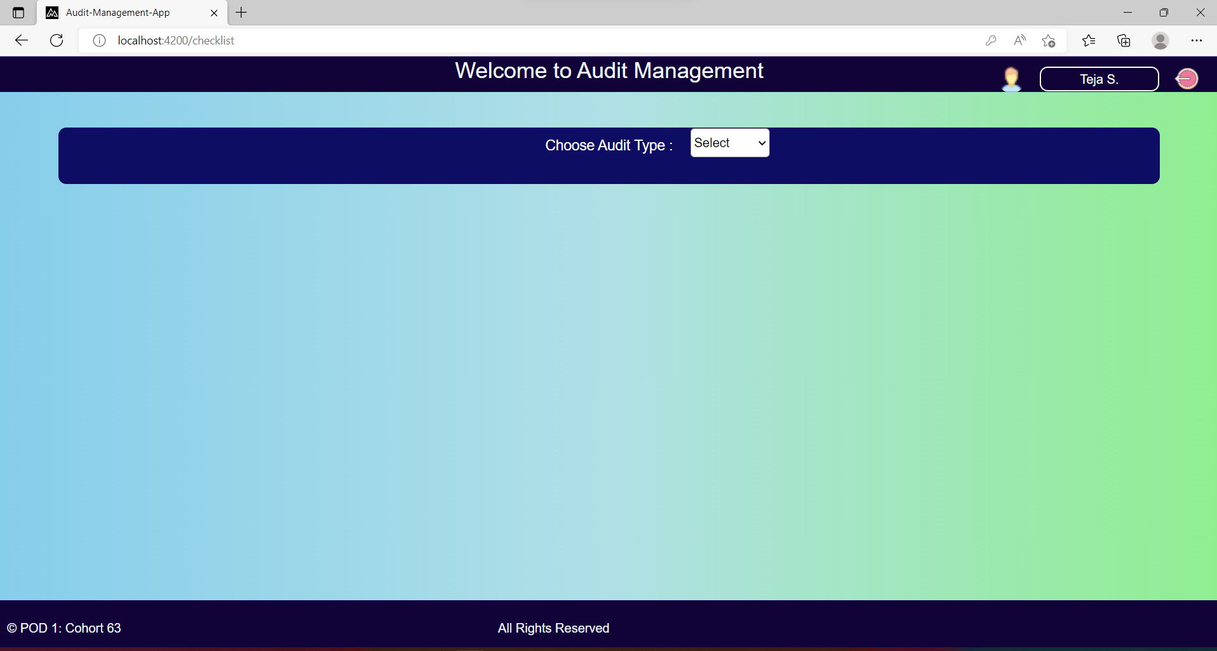

Slide 26
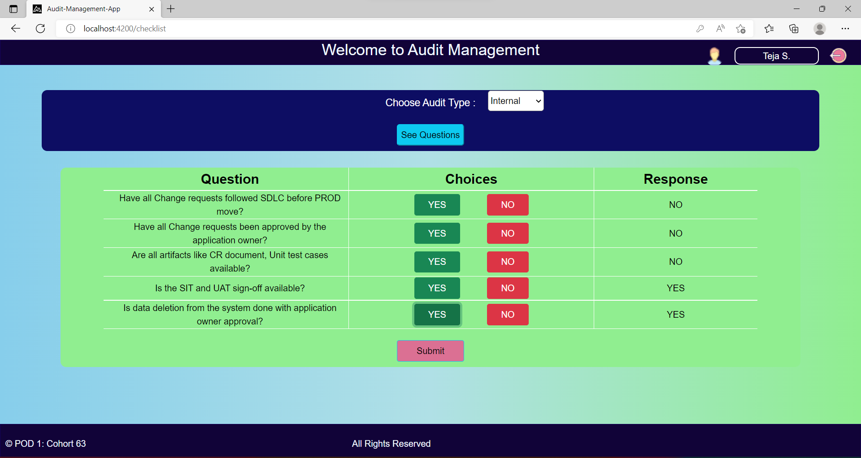

Slide 27
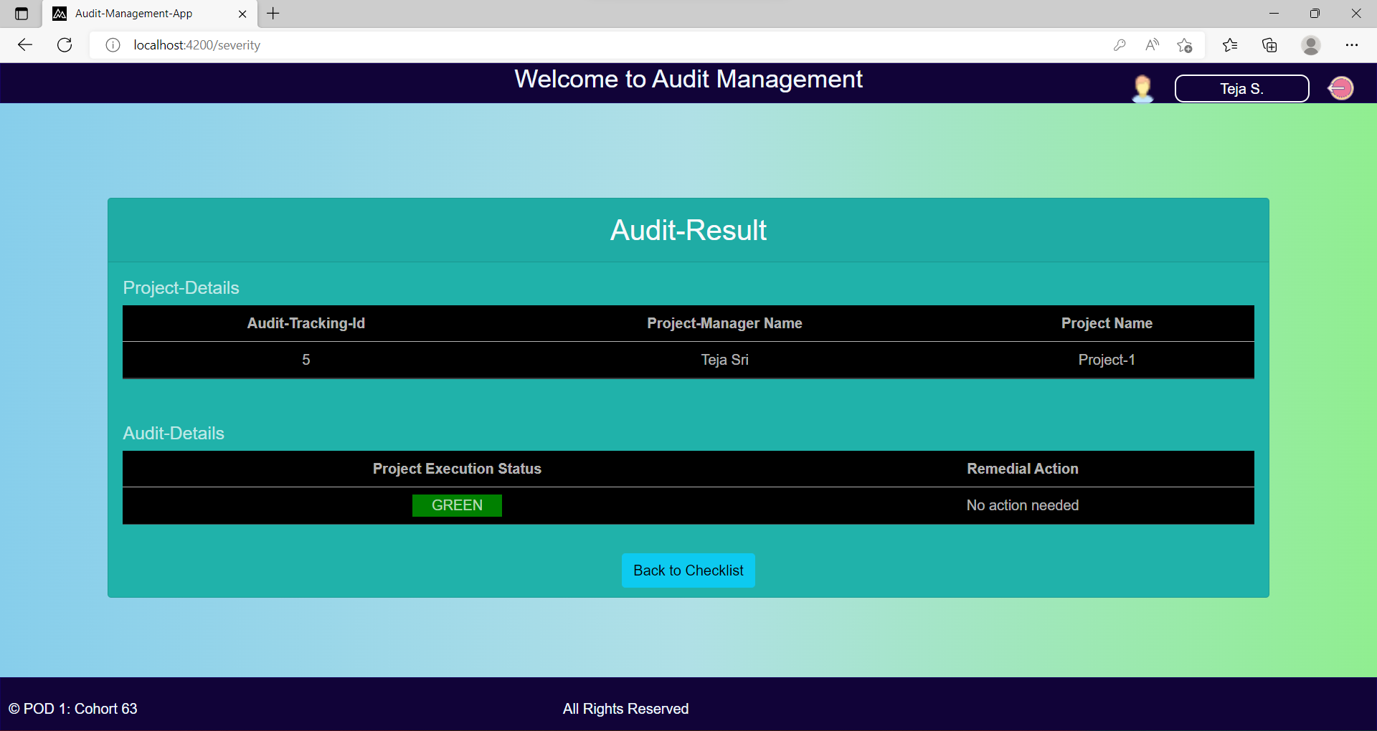

Slide 28


Slide 29
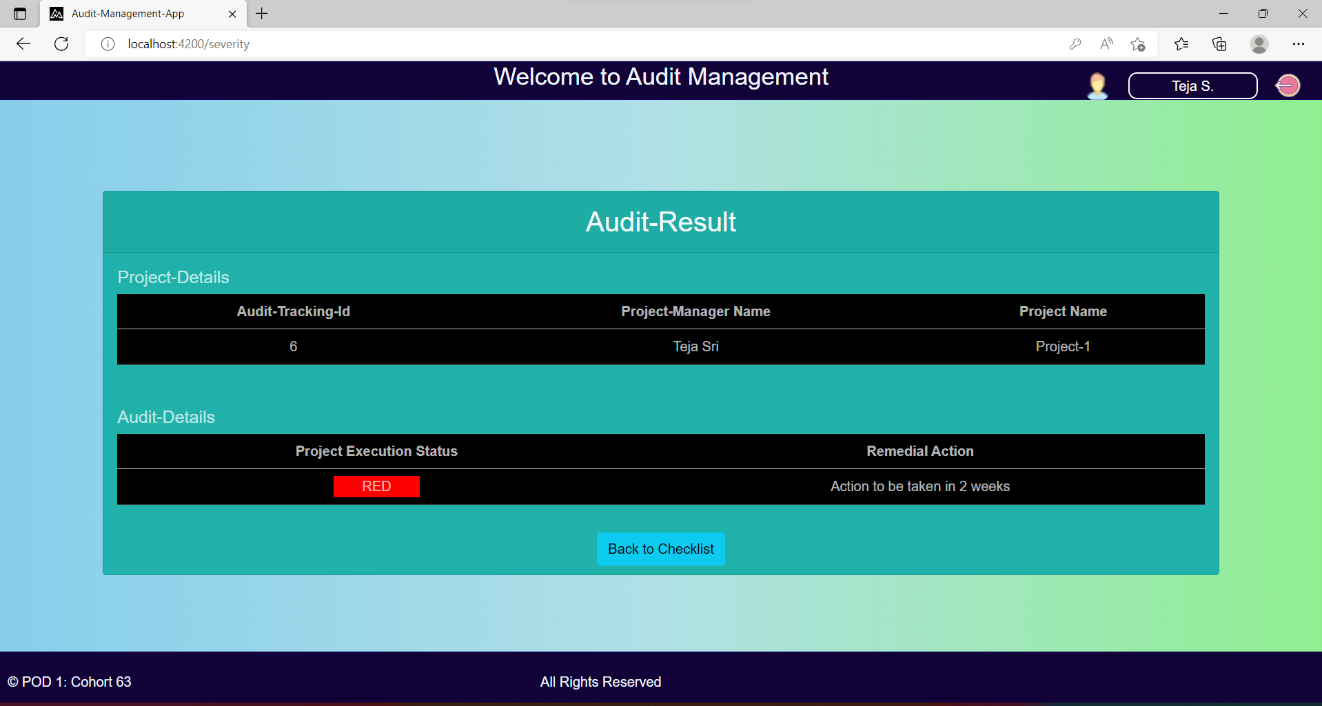

Slide 30


Slide 31


Slide 32
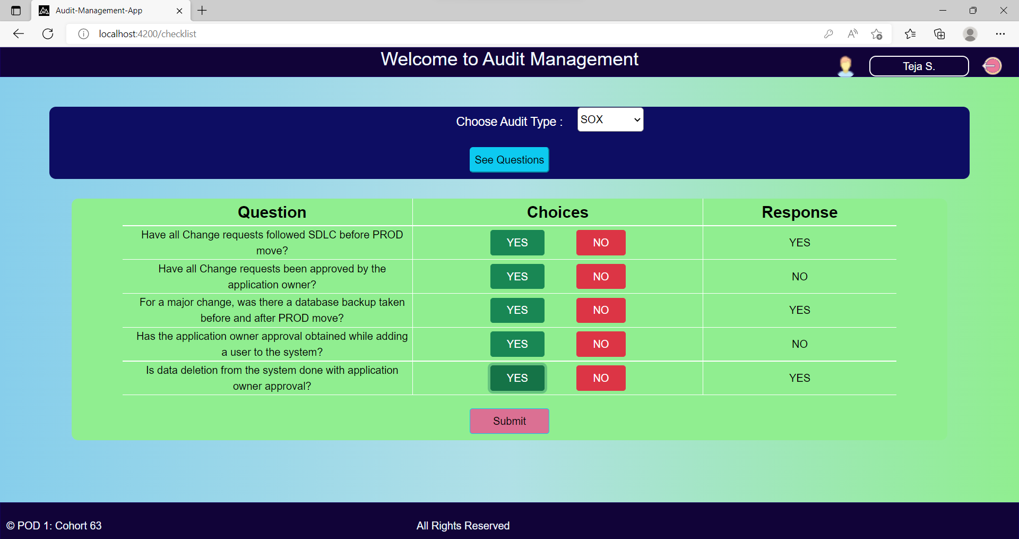

Slide 33
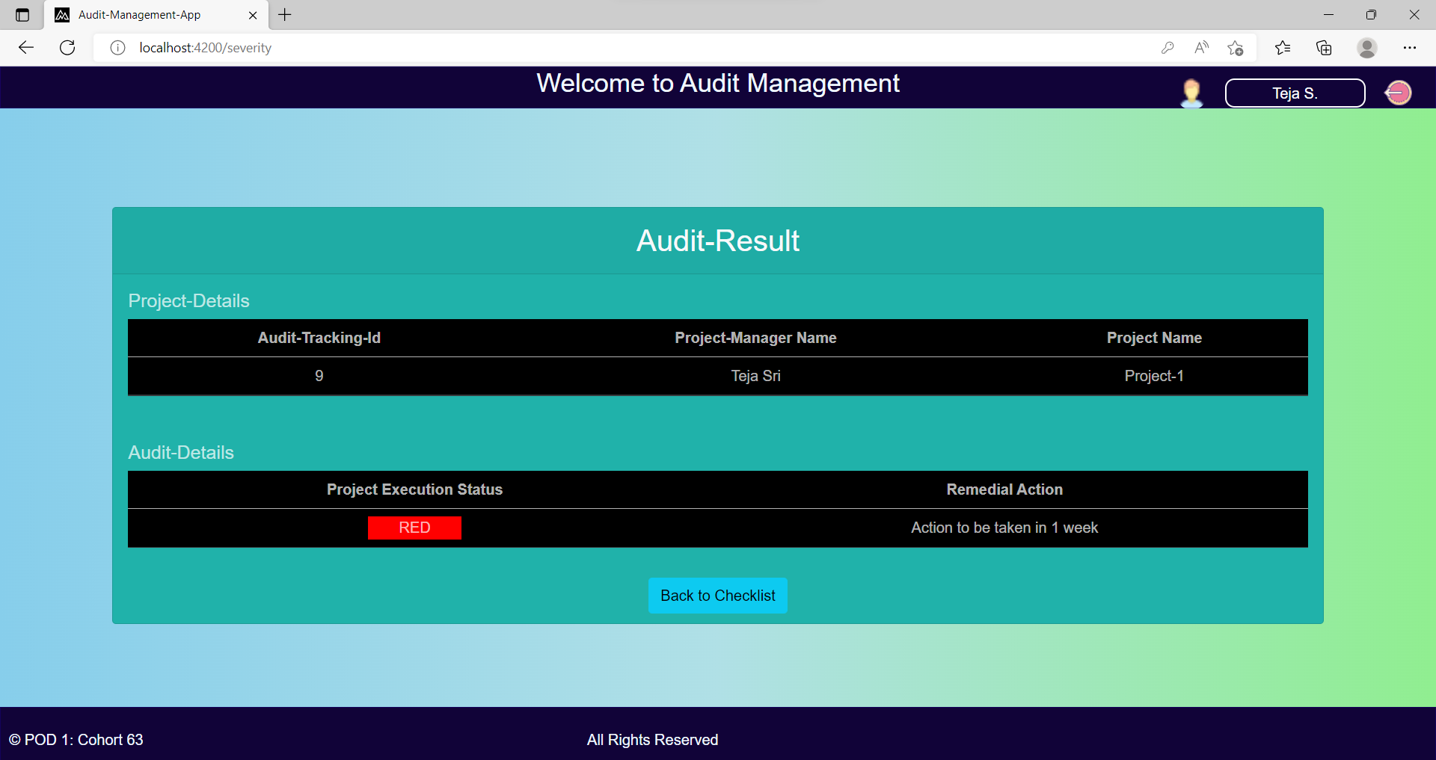

Slide 34
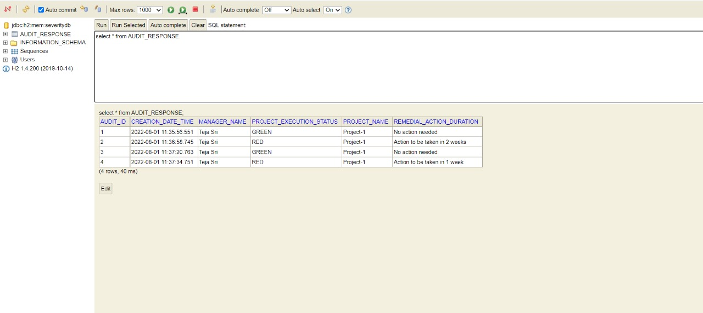
H2 Console

Slide 35
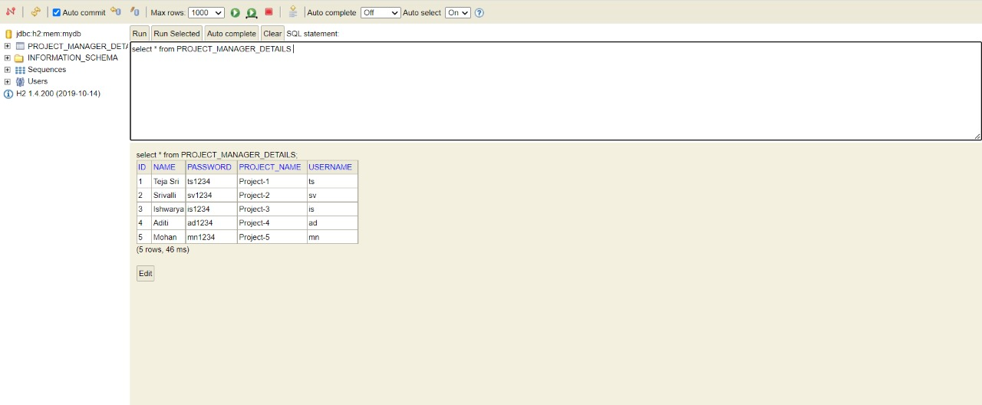

Slide 36
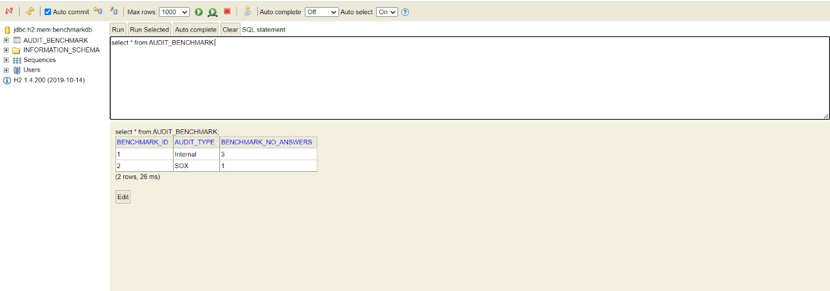

Slide 37
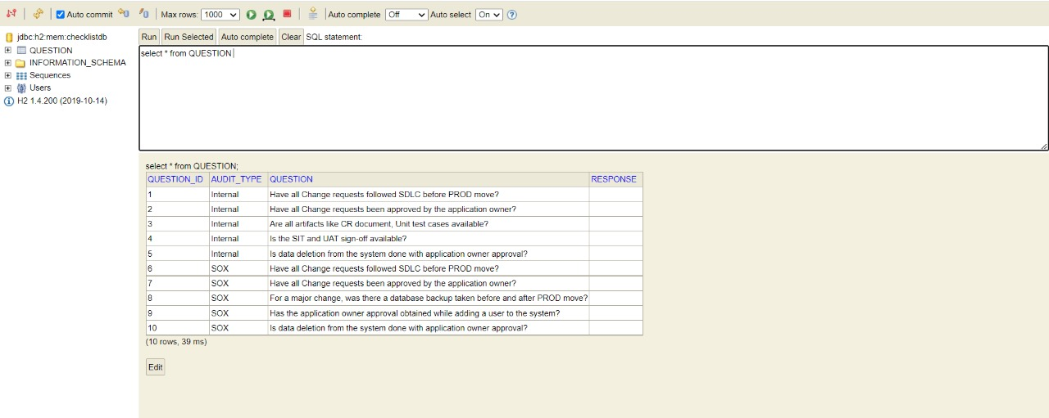

Slide 38
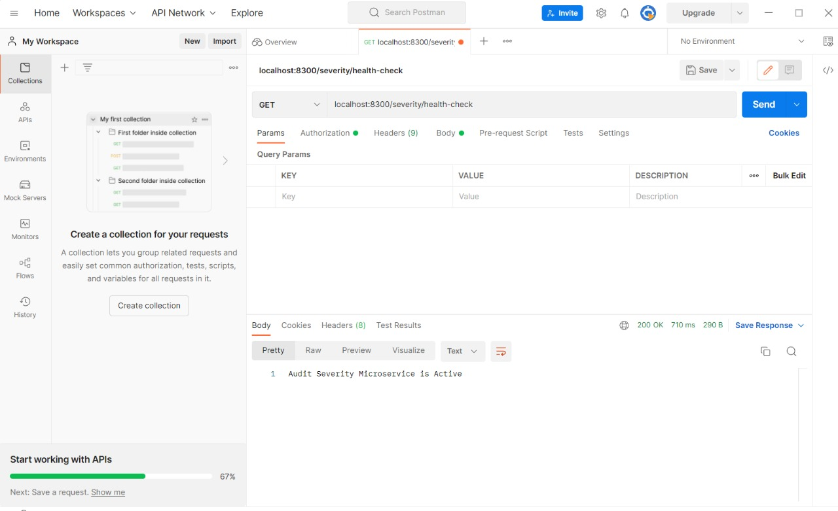
Postman

Slide 39
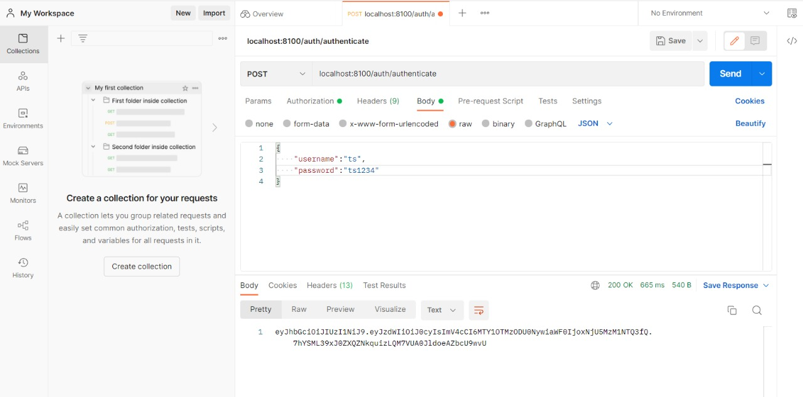

Slide 40
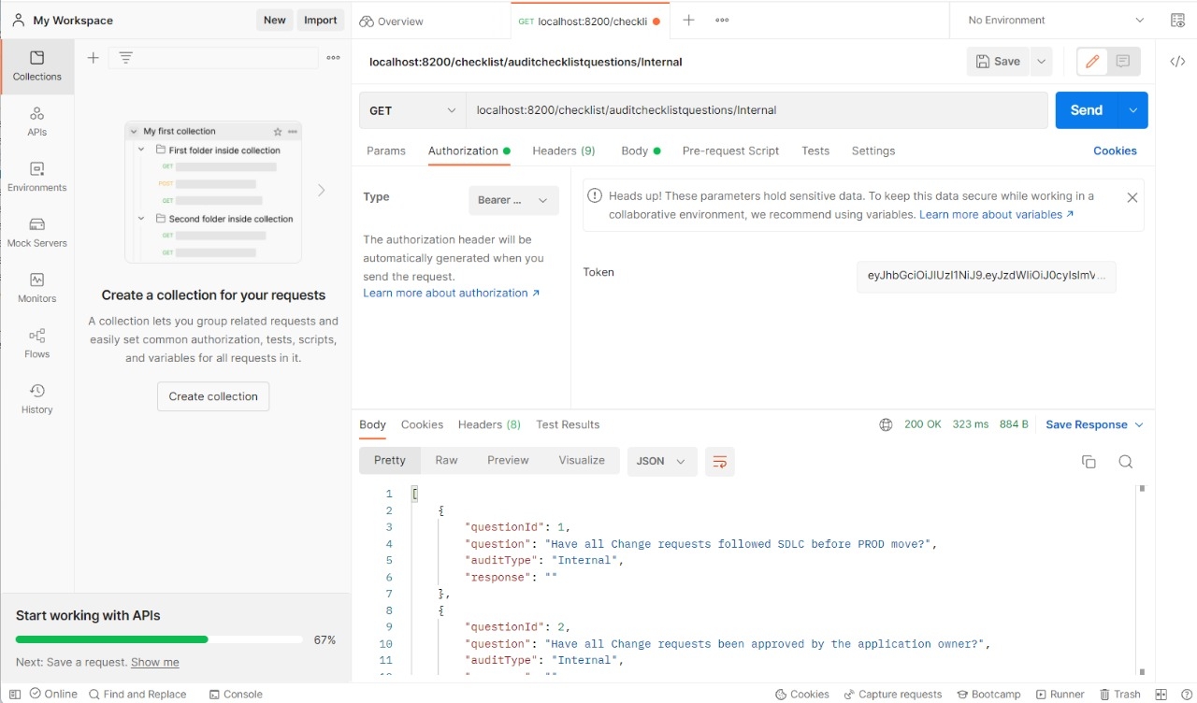

Slide 41
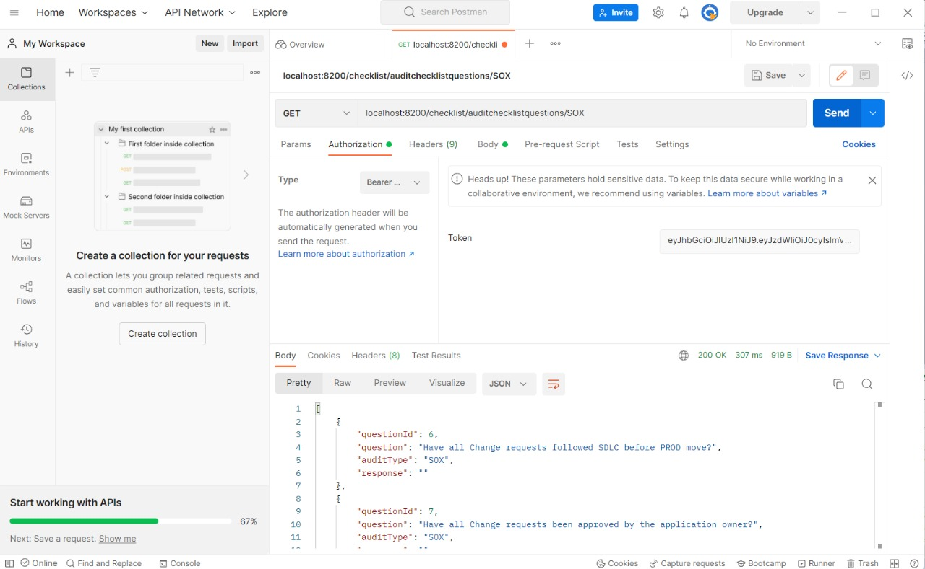

Slide 42
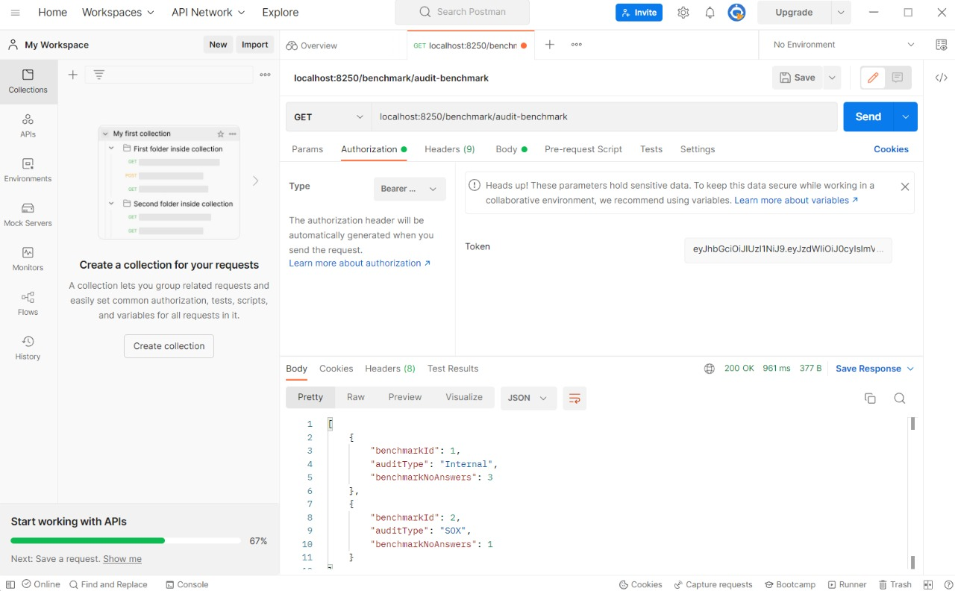

Slide 43
THANK YOU!

